Slide 1
Tutorial 1 - Week 1
We’ll be starting at the 10 minute mark

Slide 2
Agenda
TA Introductions
Logistics
Install Anaconda Navigator
Set up a Folder Structure for APS106
VSCode/Jupyter Notebook
UofT JupyterHub
Questions?

Slide 3

Introduction - TA
Sina Davari
(TUT01, TUT07)
Current studies: 3rd year PhD CIV Student
Research/other interests: Computer Vision, Singing, Hiking, Exploring New Things

Slide 4

Introduction - TA
Ali Tohidifar
(TUT01, TUT07)
Current studies: 4th year PhD CIV Student
Research/other interests: Computer Vision, Basketball, Snowboard

Slide 5
Tutorial Logistics
Tutorials are for your benefit - no grading
We will review previous weeks labs & lecture content
From Week 2, we will focus on coding problems!
Be sure to ask lots of questions and have Python open.
We are here to help you!
Questions outside of tutorial time?
Post to Piazza - all TAs/instructors and your peers can answer questions quickly
Coffee Time – drop-in hours for 1on1 help

Slide 6

Online Tutorials/Office Hours Survey
URL - https://forms.office.com/r/SrPxYxARNu

Slide 7



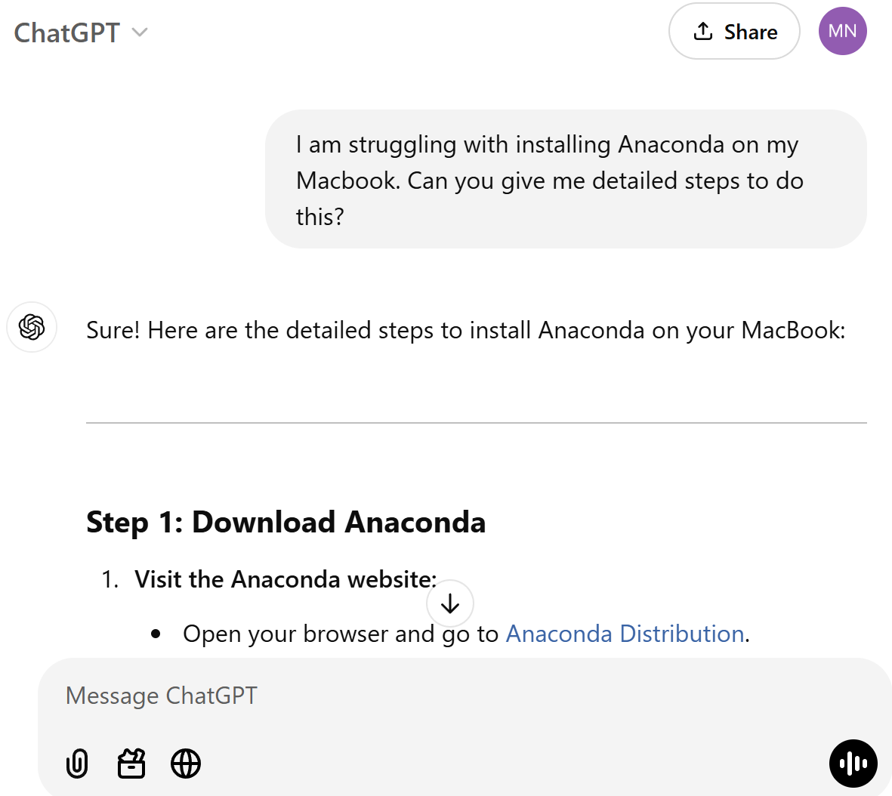

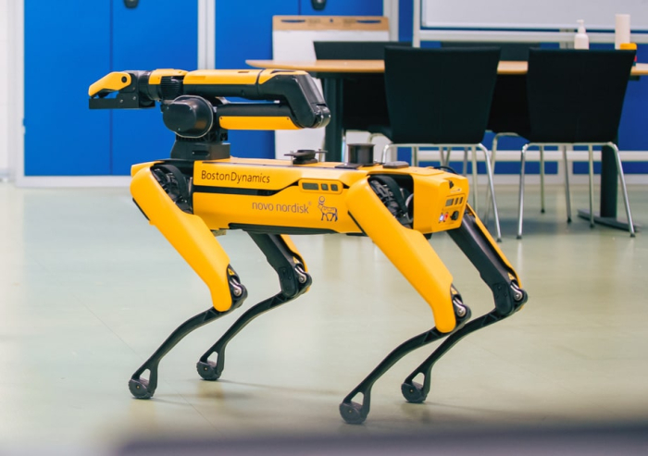
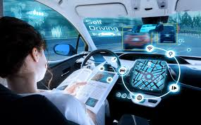
Why code?¹
Programming is awesome!
Computers are everywhere, programming is a boundless opportunity
Software engineering can be applied to almost any context in the world
Source: © Townshend et al, 2021 Science
Notes:
Chat GPT
AlphaGo
Boston Dynamics
Super Mario (video games/ 3D CG)
Autonomous driving
Ex Machina (movie about human-level conversational AI)
RNA structure prediction https://www.science.org/doi/10.1126/science.abe5650 (application to molecular biology)

Slide 8
Why code?²
Regardless of background, coding is always an achievable skill
Software engineering can be applied to almost any context in the world
NEVER THINK THAT YOU “CAN'T UNDERSTAND” CODING
Source: © Townshend et al, 2021 Science

Slide 9

What would you want to ideally learn how to do with computers?

Slide 10


What would you want to ideally learn how to do with computers?
ⓘ
Click Present with Slido or install our Chrome extension to activate this poll while presenting.
Notes:
📣 This is Slido interaction slide, please don't delete it. ✅ Click on 'Present with Slido' and the poll will launch automatically when you get to this slide.

Slide 11
Coding experience?

Slide 12

Coding experience?
ⓘ
Click Present with Slido or install our Chrome extension to activate this poll while presenting.
Notes:
📣 This is Slido interaction slide, please don't delete it. ✅ Click on 'Present with Slido' and the poll will launch automatically when you get to this slide.

Slide 13
Install Anaconda Navigator

Slide 14

Anaconda
Anaconda is a distribution of Python that includes tools and packages geared towards scientific computing (such as data science and machine learning)
Anaconda Navigator is the graphical user interface (GUI) allowing users to install and manage their programming environment without command line (terminal) prompts

Slide 15
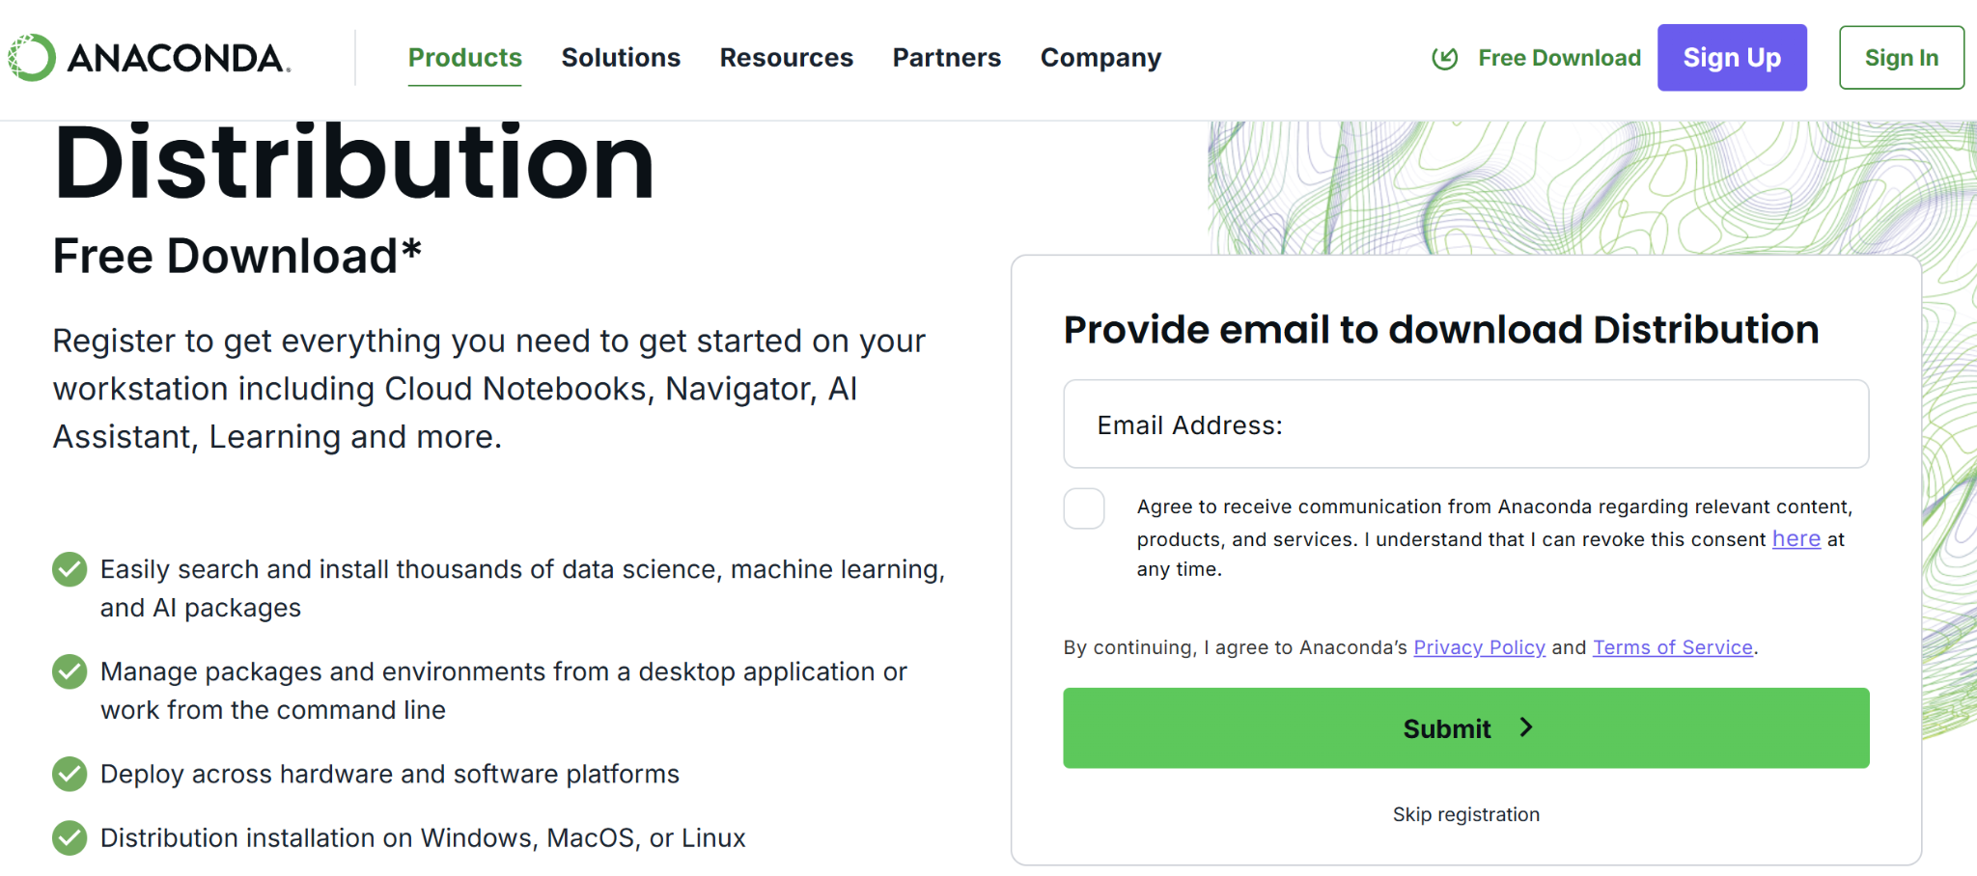
Install Anaconda
You can install Anaconda from the following link:
https://www.anaconda.com/download

Slide 16
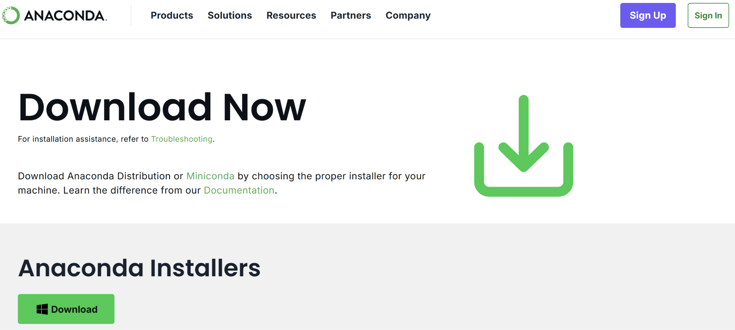
Install Anaconda
You can install Anaconda from the following link:
https://www.anaconda.com/download

Slide 17
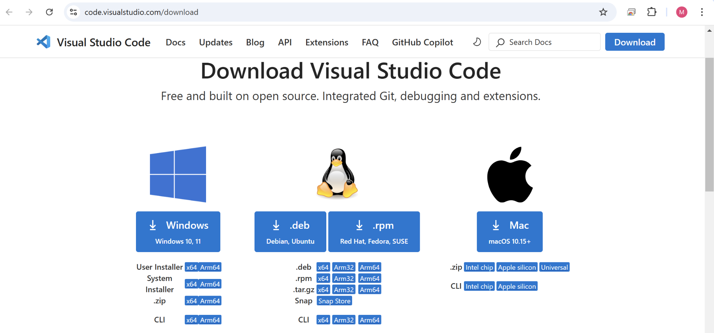
Install VS Code¹
You can install VS Code from the following link:
https://code.visualstudio.com/download

Slide 18
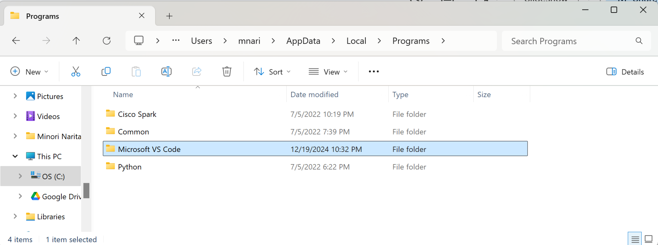
Install VS Code² (Windows)
Open the .exe file (e.g., VSCodeUserSetup-x64-1.96.2.exe) and install VS Code
Go to Anaconda-Navigator → File → Preferences → Configure Navigator → Change the following lines of code
[home]
vscode_enable = True
[applications]
vscode_path = C:\Users\{USERNAME}\AppData\Local\Programs\Microsoft VS Code
Restart Anaconda Navigator
(If you don’t see AppData, click on View -> Show -> Hidden items)

Slide 19
Install VS Code² (Windows)
Open the .exe file (e.g., VSCodeUserSetup-x64-1.96.2.exe) and install VS Code
Go to Anaconda-Navigator → File → Preferences → Configure Navigator → Change the following lines of code
[home]
vscode_enable = True
[applications]
vscode_path = C:\Users\{USERNAME}\AppData\Local\Programs\Microsoft VS Code
Restart Anaconda Navigator
Microsoft VS Code might be under C:\Program Files (x86) - if so, vscode_path should be
C:\Program Files (x86)\Microsoft VS Code
instead
(If you don’t see AppData, click on View -> Show -> Hidden items)

Slide 20
Install VS Code² (MacOS)
If archive, extract the archive contents (e.g., VSCode-darwin-universal.zip).
Drag Visual Studio Code.app to the Applications folder
Double click the VS Code icon from the Applications folder
Open Anaconda Navigator and see if you can find VS Code in Home. If not:
Open Terminal (from Finder, open the Applications/Utilities folder and double-click Terminal) and type in the following command and press Enter:
conda config --set vscode /usr/local/bin/code

Slide 21
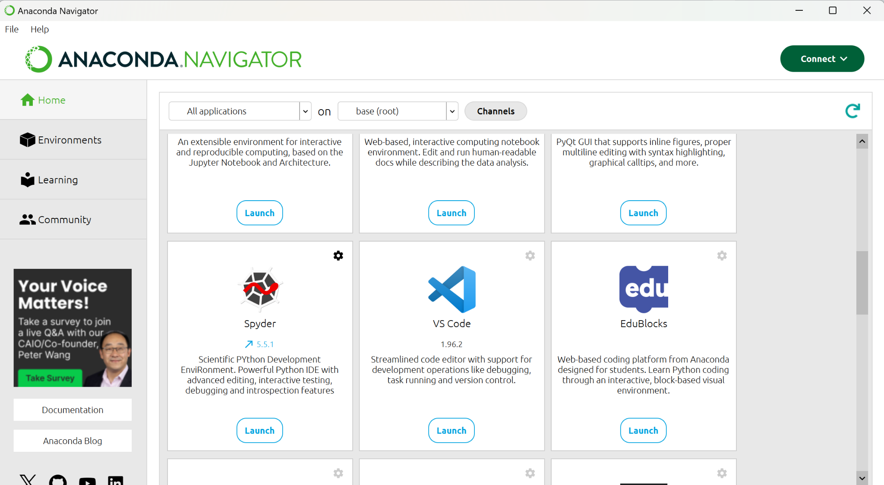
Anaconda Navigator
We will be mainly using “VS Code” in this course. Let’s click on “Launch”!

Slide 22
Set up a Folder Structure for APS106

Slide 23
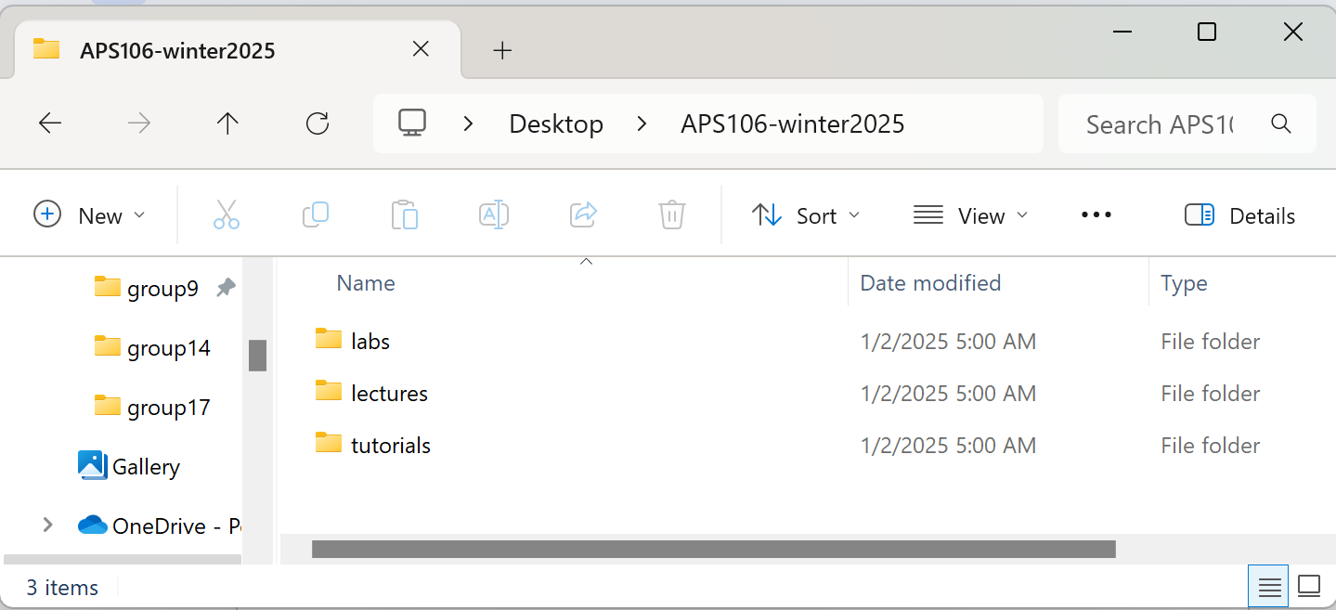
Stay Organized, Stay Efficient
It's not a good idea to store all your files in the Downloads folder!
Let's create a folder for APS106 (e.g., on Desktop) and organize your files there
lab1, lab2, …
tutorial0, tutorial1, …

Slide 24
Let’s download files from Quercus!
Go to Quercus -> Modules -> Tutorial Homepage
Click on Tutorial 0 - Setting Up A Development Environment in week1
Download “tutorial0.zip”
Unzip the zip file and move it in your folder for APS106

Slide 25
VSCode/Jupyter Notebook

Slide 26
VSCode is an IDE
Integrated Development Environments (IDEs) are programs that provides tools and features to programmers in a unified environment
IDEs often include:
A code editor
A place to type and edit code, usually with colour-coded syntax highlighting to improve readability
Code compilers or interpreters
Turns the readable Python code into something the machine can understand
Debuggers
Pause the code at pre-determined locations and go line-by-line through your code
So IDEs basically contain everything you need to code!

Slide 27
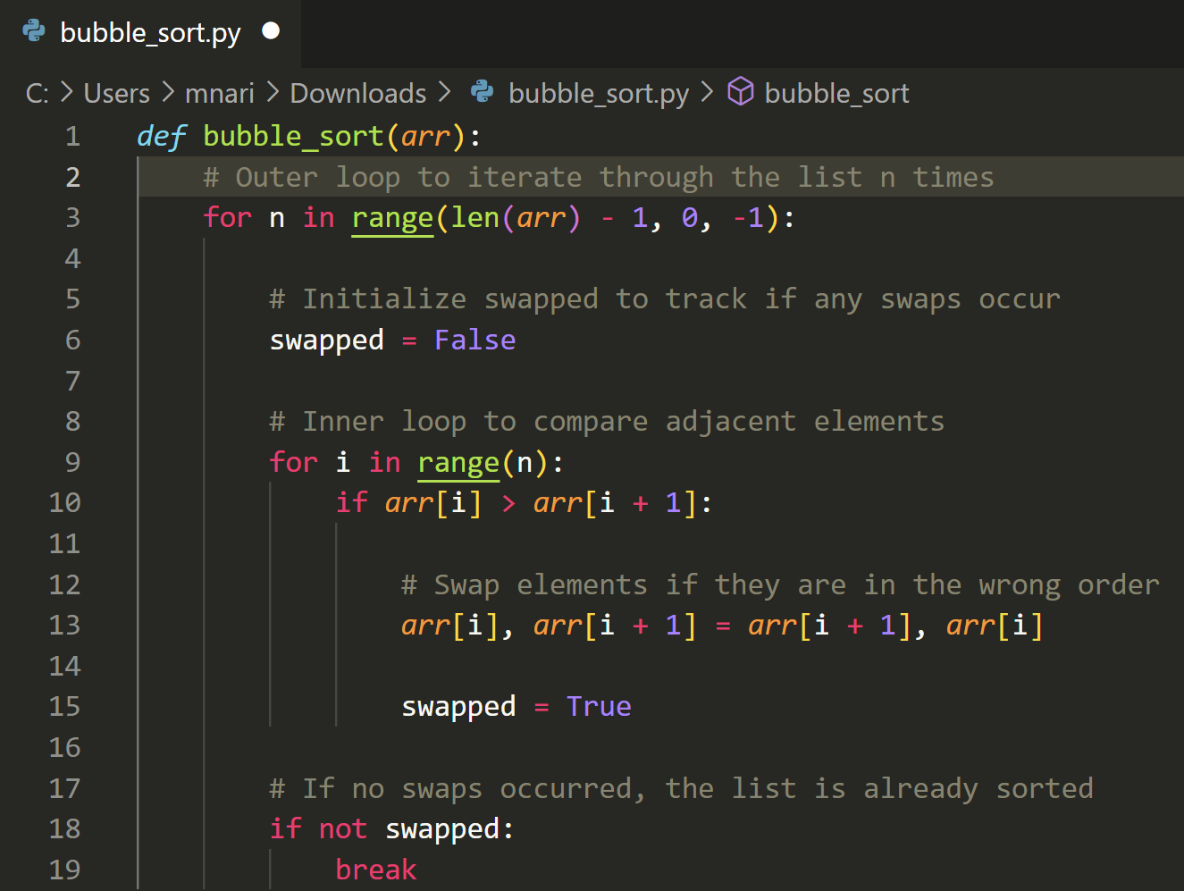
VSCode is an IDE
Integrated Development Environments (IDEs) are programs that provides tools and features to programmers in a unified environment
IDEs often include:
A code editor
A place to type and edit code, usually with colour-coded syntax highlighting to improve readability
Source

Slide 28
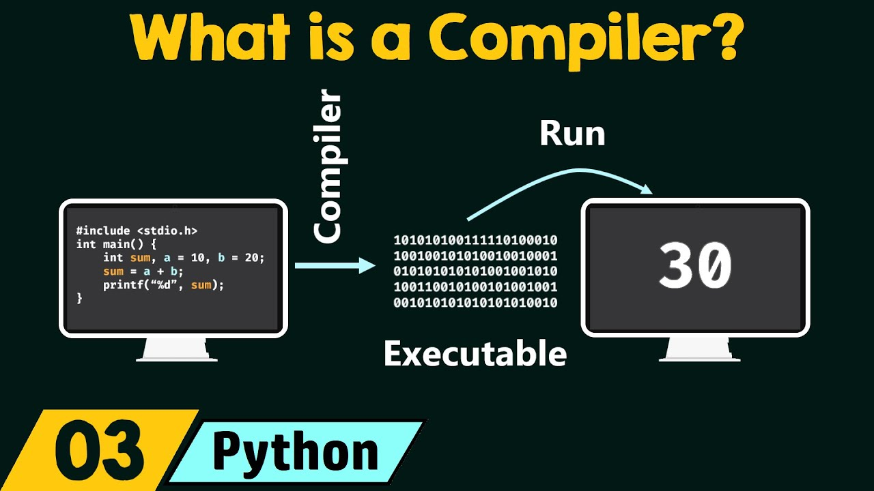
VSCode is an IDE
Integrated Development Environments (IDEs) are programs that provides tools and features to programmers in a unified environment
IDEs often include:
Code compilers or interpreters
Turns the readable Python code into something the machine can understand
Source

Slide 29
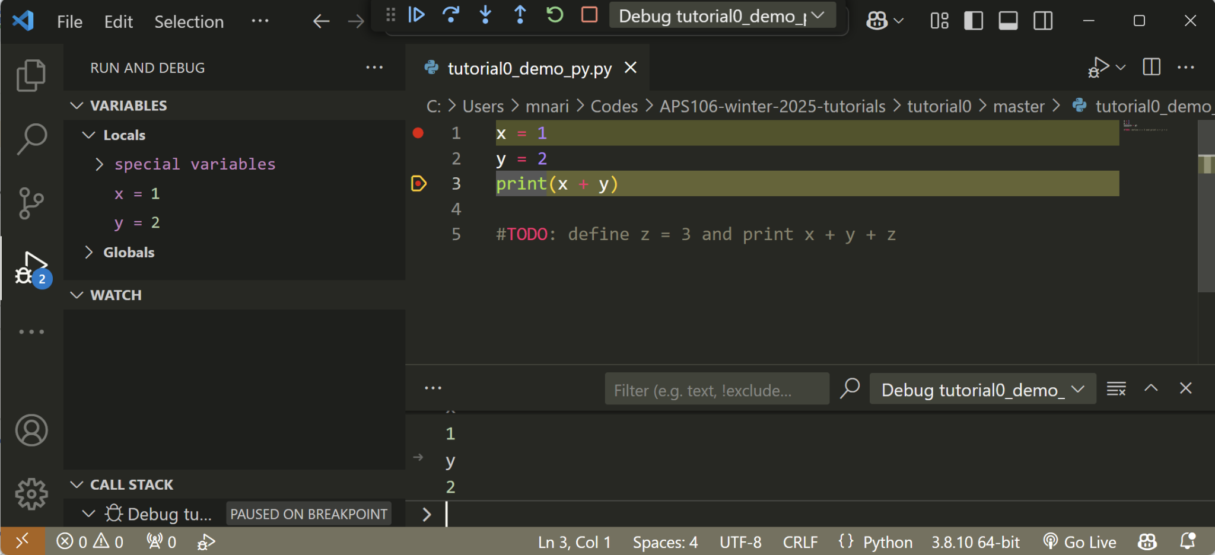
VSCode is an IDE
Integrated Development Environments (IDEs) are programs that provides tools and features to programmers in a unified environment
IDEs often include:
Debuggers
Pause the code at pre-determined locations and go line-by-line through your code
Continue, step over, step in/out, restart, stop
Run and Debug
Debug console
Source

Slide 30
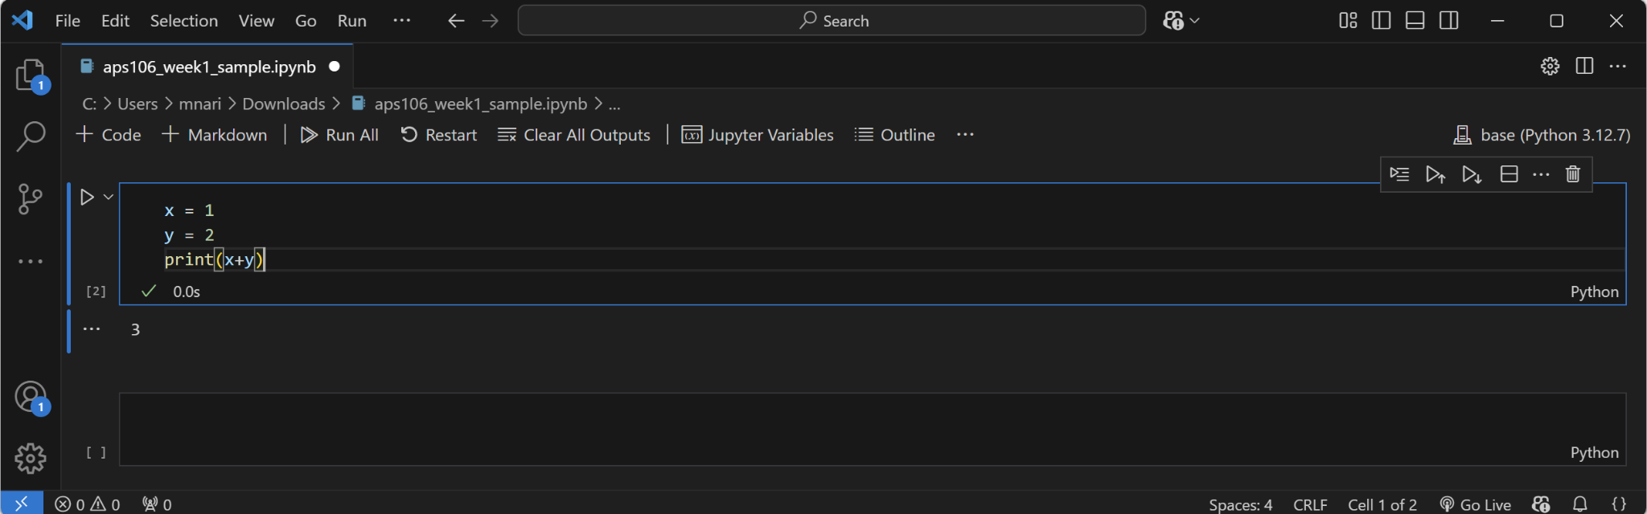
VS Code (Jupyter Notebook)
Kernel
(Python engine)
Filename
Open/Save files
File path
Code cells

Slide 31
VS Code (Jupyter Notebook)
(drag&drop or Alt + ↑ /Alt + ↓ )
Move up/down the cell
Create a new cell under the current one
Execute this cell (or Shift + Enter)
Cell
Delete the cell
Cell output

Slide 32
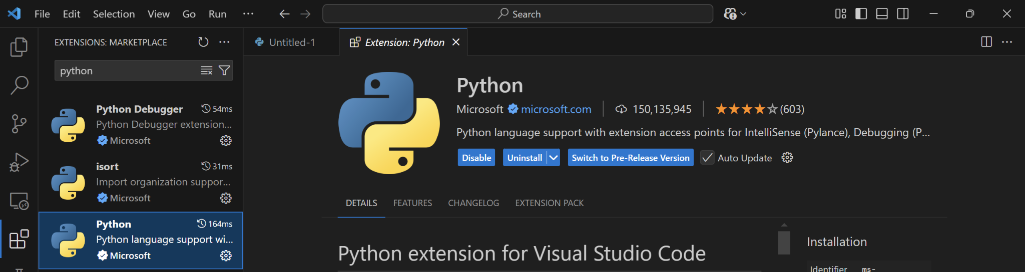
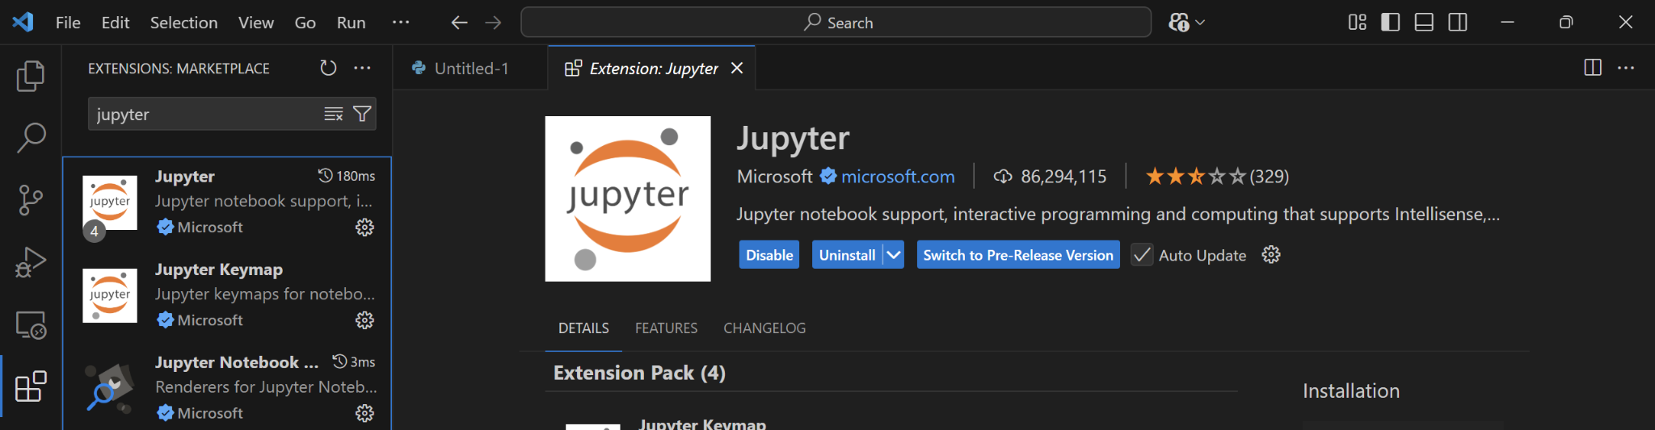
VS Code (Jupyter Notebook)
Make sure you have “Python” and “Jupyter” extensions installed!

Slide 33
Let’s practice!¹
Let’s open tutorial0_demo_jupyter.ipynb, write our first program, and save it!
Steps:
Launch VS Code through Anaconda Navigator
File -> Open File -> Go to the APS106 folder and select tutorial0_demo_jupyter.ipynb
In the first code cell, write
print("Hello World!")
Execute the cell (if asked, select “base (Python 3.12.7)”)
File -> Save as -> save it as “tutorial0_demo_jupyter.ipynb”

Slide 34
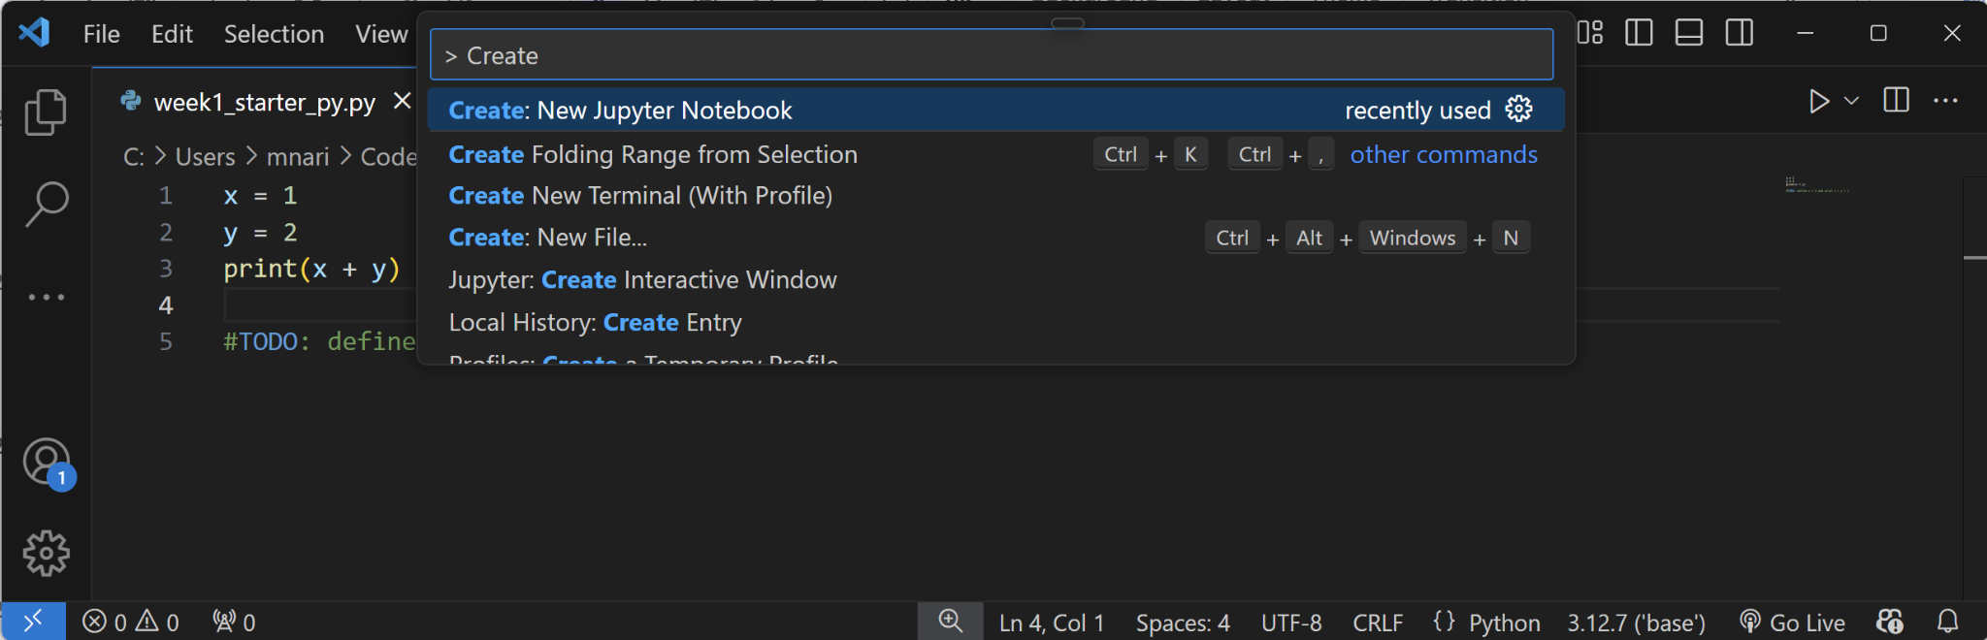
Create a new Jupyter Notebook
You can create a new notebook on VS Code too!
Steps:
Launch VS Code through Anaconda Navigator
In the command palette (“Search” on top), type in “> create new jupyter notebook” and select “Create: New Jupyter Notebook”

Slide 35
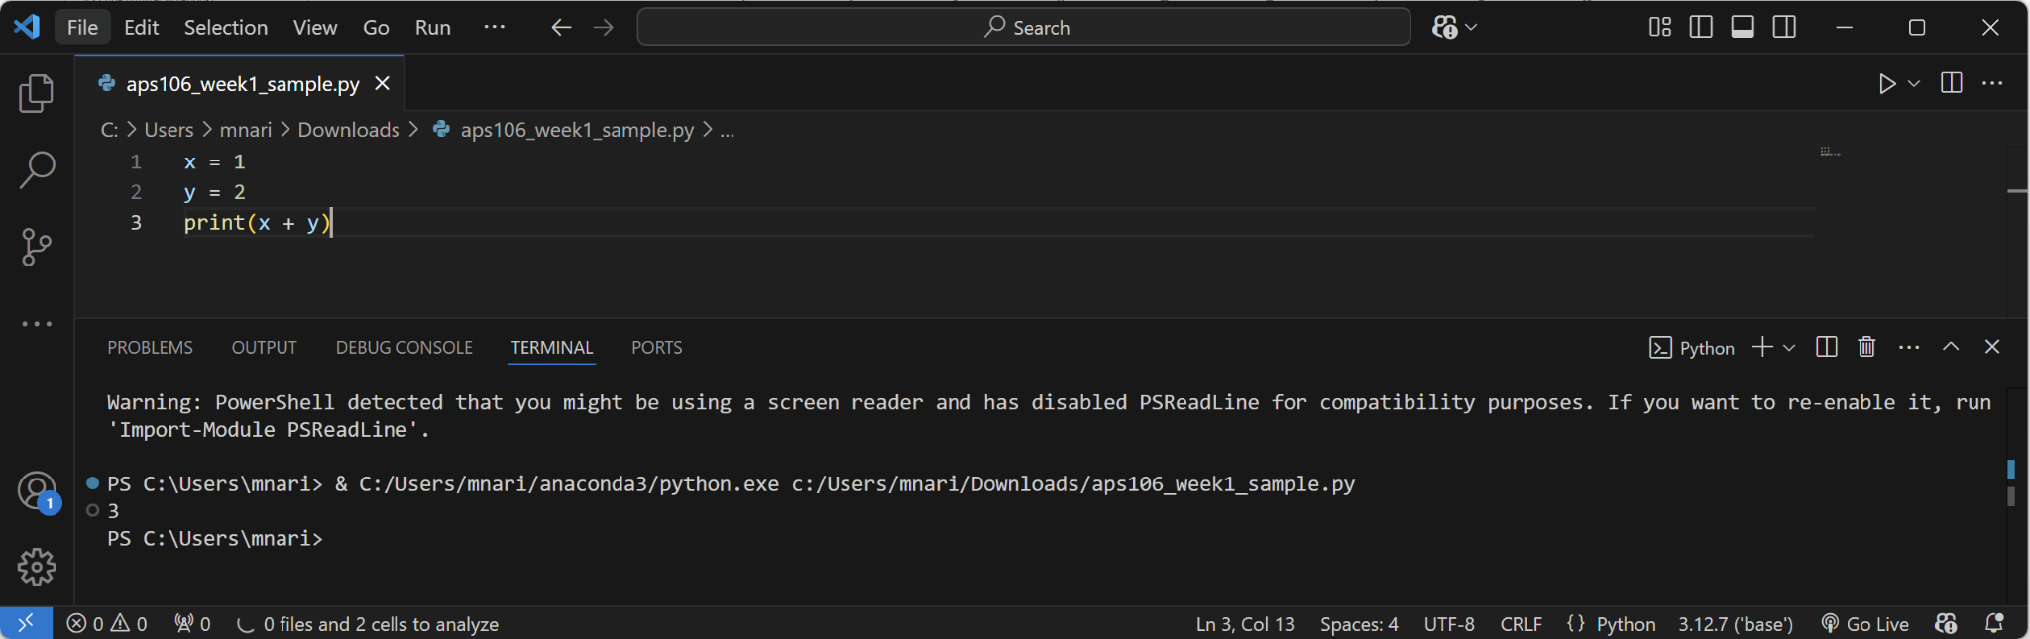
VS Code (Python script)
Execute the Python script
When you open a .py file, an editor with a different layout appears
Editor Pane
Terminal

Slide 36
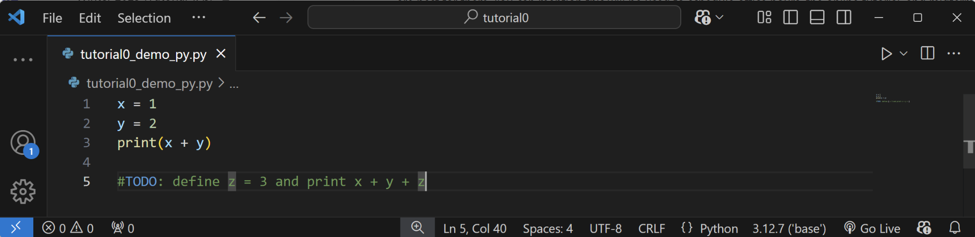
Let’s practice!²
Let’s open tutorial0_demo_py.py in VS Code, modify the code based on the instruction, and run it!

Slide 37
We'll switch from .ipynb to .py files later
Jupyter Notebooks (.ipynb) are interactive and beginner-friendly
Python scripts (.py) are the standard format for Python programs and are suited for building and running larger projects
We’ll switch to .py files in lab5!

Slide 38
UofT JupyterHub

Slide 39
What is UofT JupyterHub?
Access at https://jupyter.utoronto.ca/
Cloud-based Jupyter Notebook service that allows us to run Jupyter Notebooks (.ipynb files) directly from a web browser
Don’t need to install anything
Linked to your UofT account, all lecture notes are stored as a copy in JupyterHub!
Notes:
UofT JupyterHub is a cloud-based Jupyter Notebook service provided by the University of Toronto. It allows students, faculty, and researchers to run Python and other programming environments directly from a web browser without needing to install anything on their local machines.

Slide 40
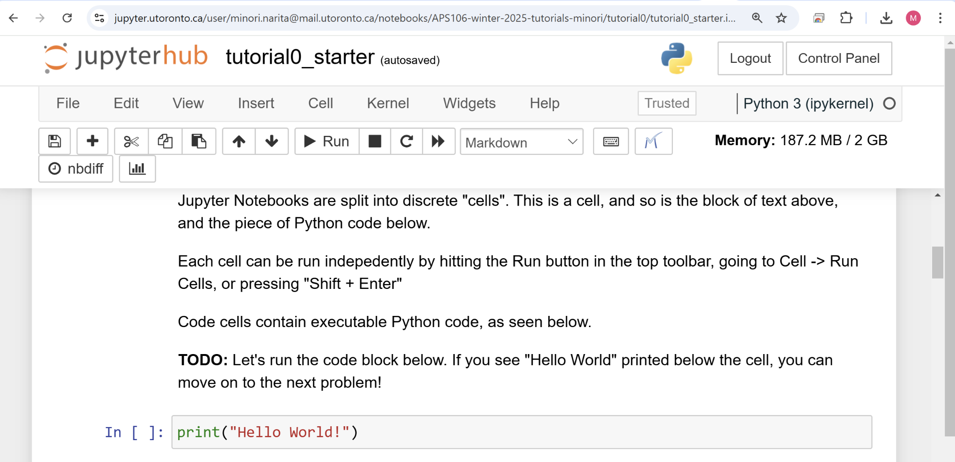
Let’s try UofT JupyterHub!
Go to Tutorial Homepage in APS106 Modules on Quercus
Click on Tutorial 0 - Setting Up A Development Environment in week1
-> Click on JupyterHub Starter Link

